Slide 1
CNN
Teoh Teik Toe
ITOM/NBS
ttteoh@ntu.edu.sg
97905202

Slide 2
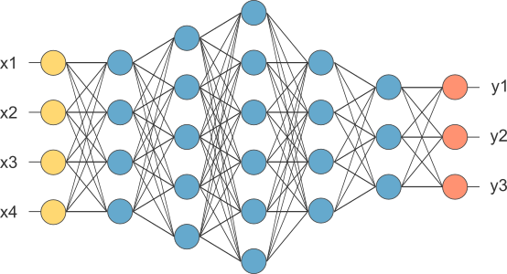
Multi Layer Perceptron
This is our fully connected network. If x_{1 .}... x_{n}, n is very large and growing,
this network would become too large. We now will input one x_{i} at a time,
and re-use the same edge weights.

Slide 3



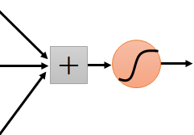


Same pattern appears in different places: They can be compressed! What about training a lot of such “small” detectors and each detector must “move around”.
“upper-left beak” detector
They can be compressed
to the same parameters.
“middle beak” detector

Slide 4
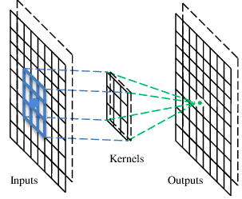
A convolutional layer
A CNN is a neural network with some convolutional layers
(and some other layers). A convolutional layer has a number
of filters that does convolutional operation.
Beak detector
A filter

Slide 5
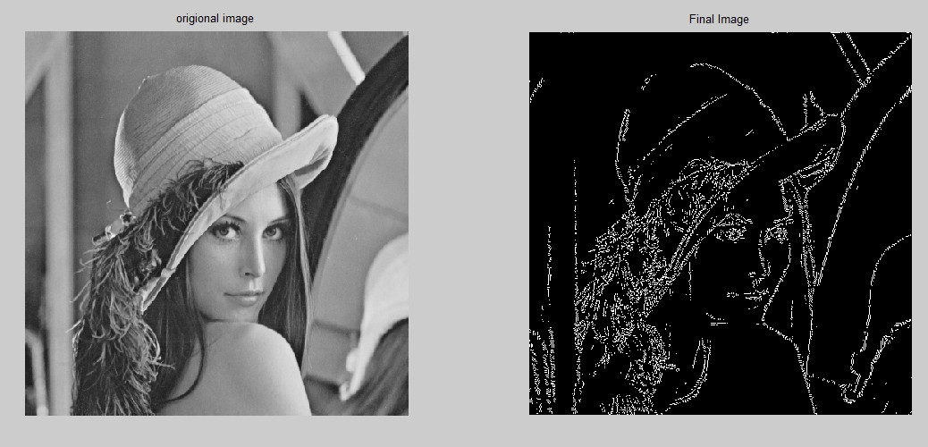
Popular filter - Sober

Slide 6
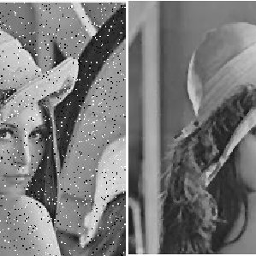
Remove Noise Filter

Slide 7
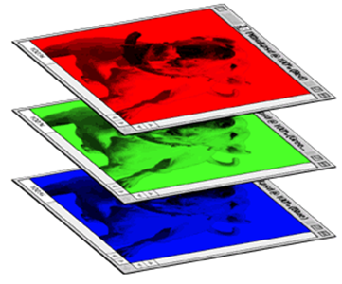
CNN – Colorful image
1 | -1 | -1
-1 | 1 | -1
-1 | -1 | 1
-1 | 1 | -1
-1 | 1 | -1
-1 | 1 | -1
1 | -1 | -1
-1 | 1 | -1
-1 | -1 | 1
-1 | 1 | -1
-1 | 1 | -1
-1 | 1 | -1
1 | -1 | -1
-1 | 1 | -1
-1 | -1 | 1
-1 | 1 | -1
-1 | 1 | -1
-1 | 1 | -1
Filter 1
Filter 2
Colorful image
1 | 0 | 0 | 0 | 0 | 1
0 | 1 | 0 | 0 | 1 | 0
0 | 0 | 1 | 1 | 0 | 0
1 | 0 | 0 | 0 | 1 | 0
0 | 1 | 0 | 0 | 1 | 0
0 | 0 | 1 | 0 | 1 | 0
1 | 0 | 0 | 0 | 0 | 1
0 | 1 | 0 | 0 | 1 | 0
0 | 0 | 1 | 1 | 0 | 0
1 | 0 | 0 | 0 | 1 | 0
0 | 1 | 0 | 0 | 1 | 0
0 | 0 | 1 | 0 | 1 | 0
1 | 0 | 0 | 0 | 0 | 1
0 | 1 | 0 | 0 | 1 | 0
0 | 0 | 1 | 1 | 0 | 0
1 | 0 | 0 | 0 | 1 | 0
0 | 1 | 0 | 0 | 1 | 0
0 | 0 | 1 | 0 | 1 | 0

Slide 8
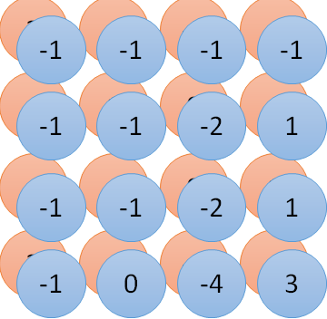
Convolution v.s. Fully Connected
1 | 0 | 0 | 0 | 0 | 1
0 | 1 | 0 | 0 | 1 | 0
0 | 0 | 1 | 1 | 0 | 0
1 | 0 | 0 | 0 | 1 | 0
0 | 1 | 0 | 0 | 1 | 0
0 | 0 | 1 | 0 | 1 | 0
1 | -1 | -1
-1 | 1 | -1
-1 | -1 | 1
-1 | 1 | -1
-1 | 1 | -1
-1 | 1 | -1
convolution
image
1 | 0 | 0 | 0 | 0 | 1
0 | 1 | 0 | 0 | 1 | 0
0 | 0 | 1 | 1 | 0 | 0
1 | 0 | 0 | 0 | 1 | 0
0 | 1 | 0 | 0 | 1 | 0
0 | 0 | 1 | 0 | 1 | 0
Fully-connected
……
……

Slide 9
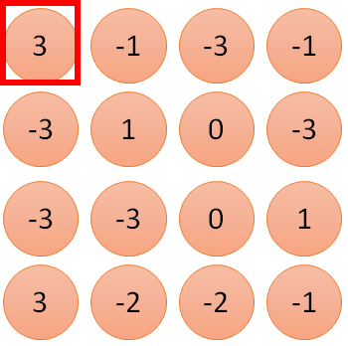
1 | -1 | -1
-1 | 1 | -1
-1 | -1 | 1
1:
1
Filter 1
2:
0
3:
0
3
4:
0
1 | 0 | 0 | 0 | 0 | 1
0 | 1 | 0 | 0 | 1 | 0
0 | 0 | 1 | 1 | 0 | 0
1 | 0 | 0 | 0 | 1 | 0
0 | 1 | 0 | 0 | 1 | 0
0 | 0 | 1 | 0 | 1 | 0
…
7:
0
8:
1
9:
0
10:
0
…
13:
0
6 x 6 image
14:
0
Less parameters!
15:
Only connect to 9 input, not fully connected
1
16:
1
…

Slide 10
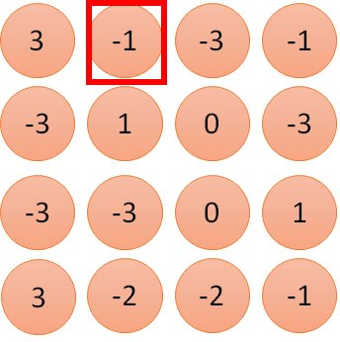
1 | -1 | -1
-1 | 1 | -1
-1 | -1 | 1
1:
1
Filter 1
2:
0
3:
0
3
4:
0
1 | 0 | 0 | 0 | 0 | 1
0 | 1 | 0 | 0 | 1 | 0
0 | 0 | 1 | 1 | 0 | 0
1 | 0 | 0 | 0 | 1 | 0
0 | 1 | 0 | 0 | 1 | 0
0 | 0 | 1 | 0 | 1 | 0
…
7:
0
8:
1
-1
9:
0
10:
0
…
13:
0
6 x 6 image
14:
0
Less parameters!
15:
1
16:
1
Shared weights
Even less parameters!
…

Slide 11
Convolution
1 | -1 | -1
-1 | 1 | -1
-1 | -1 | 1
Filter 1
stride=1
stride=2
1 | 0 | 0 | 0 | 0 | 1
0 | 1 | 0 | 0 | 1 | 0
0 | 0 | 1 | 1 | 0 | 0
1 | 0 | 0 | 0 | 1 | 0
0 | 1 | 0 | 0 | 1 | 0
0 | 0 | 1 | 0 | 1 | 0
1 | 0 | 0 | 0 | 0 | 1
0 | 1 | 0 | 0 | 1 | 0
0 | 0 | 1 | 1 | 0 | 0
1 | 0 | 0 | 0 | 1 | 0
0 | 1 | 0 | 0 | 1 | 0
0 | 0 | 1 | 0 | 1 | 0
3
-1
6 x 6 image
6 x 6 image

Slide 12
Convolution
1 | -1 | -1
-1 | 1 | -1
-1 | -1 | 1
Filter 1
stride=1
1 | 0 | 0 | 0 | 0 | 1
0 | 1 | 0 | 0 | 1 | 0
0 | 0 | 1 | 1 | 0 | 0
1 | 0 | 0 | 0 | 1 | 0
0 | 1 | 0 | 0 | 1 | 0
0 | 0 | 1 | 0 | 1 | 0
3
-1
-3
-1
-3
1
0
-3
-3
-3
0
1
3
-2
-2
-1
6 x 6 image

Slide 13
Convolution
-1 | 1 | -1
-1 | 1 | -1
-1 | 1 | -1
Filter 2
stride=1
Repeat this for each filter
1 | 0 | 0 | 0 | 0 | 1
0 | 1 | 0 | 0 | 1 | 0
0 | 0 | 1 | 1 | 0 | 0
1 | 0 | 0 | 0 | 1 | 0
0 | 1 | 0 | 0 | 1 | 0
0 | 0 | 1 | 0 | 1 | 0
3
-1
-3
-1
-1
-1
-1
-1
-3
1
0
-3
-1
-1
-2
1
Feature
Map
-3
-3
0
1
-1
-1
-2
1
3
-2
-2
-1
6 x 6 image
-1
0
-4
3
Two 4 x 4 images
Forming 2 x 4 x 4 matrix

Slide 14


The whole CNN
cat dog ……
Convolution
Max Pooling
Can repeat many times
Fully Connected Feedforward network
Convolution
Max Pooling
Flattened

Slide 15
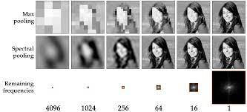
Max Pooling

Slide 16
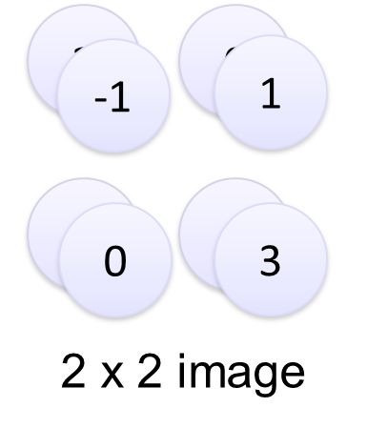
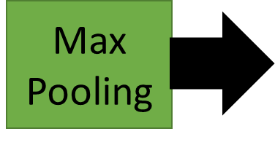
Max Pooling
-1 | 1 | -1
-1 | 1 | -1
-1 | 1 | -1
Filter 2
-1
-1
-1
-1
-1
-1
-2
1
-1
-1
-2
1
-1
0
-4
3

Slide 17
Max Pooling
New image
but smaller
1 | 0 | 0 | 0 | 0 | 1
0 | 1 | 0 | 0 | 1 | 0
0 | 0 | 1 | 1 | 0 | 0
1 | 0 | 0 | 0 | 1 | 0
0 | 1 | 0 | 0 | 1 | 0
0 | 0 | 1 | 0 | 1 | 0
Conv
3
0
-1
1
Max
Pooling
3
1
0
3
2 x 2 image
6 x 6 image
Each filter
is a channel

Slide 18


Why Pooling
Subsampling pixels will not change the object
bird
bird
Subsampling
We can subsample the pixels to make image smaller
fewer parameters to characterize the image

Slide 19
The whole CNN
3
0
-1
1
Convolution
3
1
0
3
Max Pooling
Can repeat many times
A new image
Convolution
Smaller than the original image
The number of channels is the number of filters
Max Pooling

Slide 20
Flattening
3
0
1
3
0
-1
1
3
3
1
-1
0
3
Flattened
1
Fully Connected Feedforward network
0
3

Slide 21
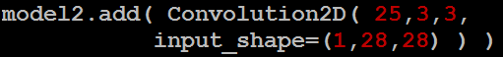
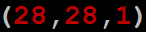
CNN in Keras
Only modified the network structure and input format (vector -> 3-D tensor)
input
Convolution
1 | -1 | -1
-1 | 1 | -1
-1 | -1 | 1
-1 | 1 | -1
-1 | 1 | -1
-1 | 1 | -1
There are 25 3x3 filters.
……
Max Pooling
Input_shape = ( 28 , 28 , 1)
28 x 28 pixels
1: black/white, 3: RGB
Convolution
3
-1
3
Max Pooling
-3
1

Slide 22
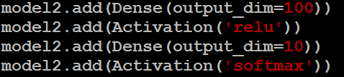
CNN in Keras
Only modified the network structure and input format (vector -> 3-D array)
Input
1 x 28 x 28
Output
Convolution
25 x 26 x 26
Fully connected feedforward network
Max Pooling
25 x 13 x 13
Convolution
50 x 11 x 11
Max Pooling
1250
50 x 5 x 5
Flattened

Slide 23

What is Convolutional NN ?
2x2
Convolution + NL
Sub-sampling
Convolution + NL

Slide 24
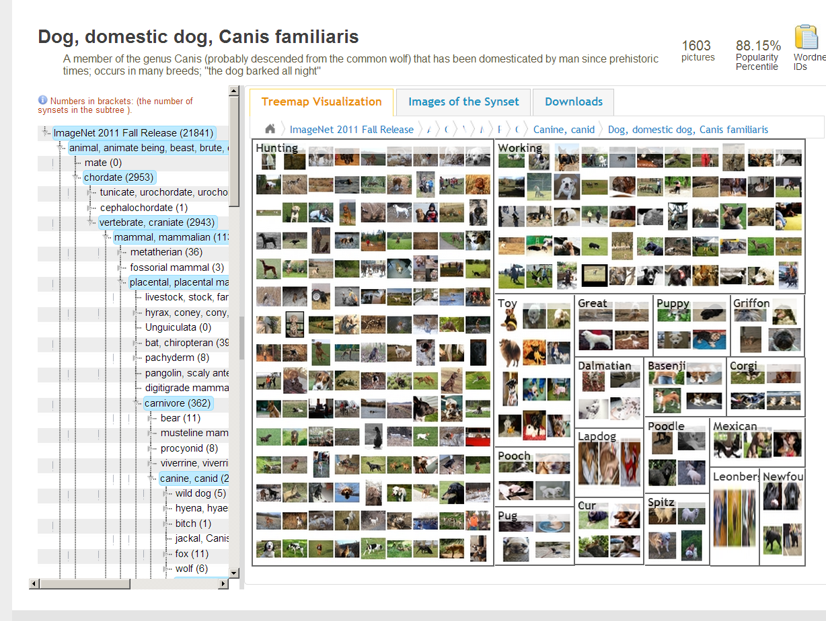
CNN success story: ILSVRC 2012
Imagenet data base: 14 mln labeled images, 20K categories

Slide 25
CNN applications
Transfer learning
Fine-tuning the CNN
Keep some early layers
Early layers contain more generic features, edges, color blobs
Common to many visual tasks
Fine-tune the later layers
More specific to the details of the class
CNN as feature extractor
Remove the last fully connected layer
A kind of descriptor or CNN codes for the image
AlexNet gives a 4096 Dim descriptor
Notes:
http://cs231n.github.io/neural-networks-1/

Slide 26
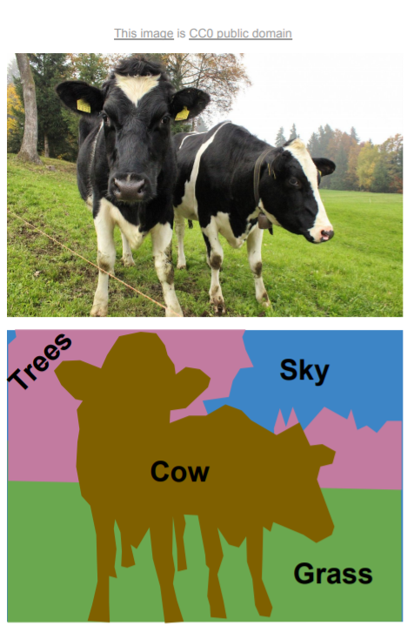
Semantic segmentation

Slide 27
Conv NN: Detection
Sermanet, CVPR 2014

Slide 28
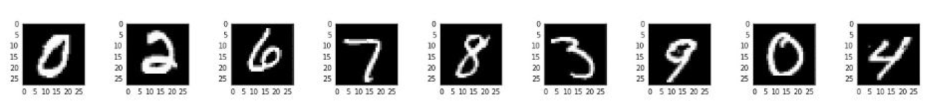
Classification

Slide 29
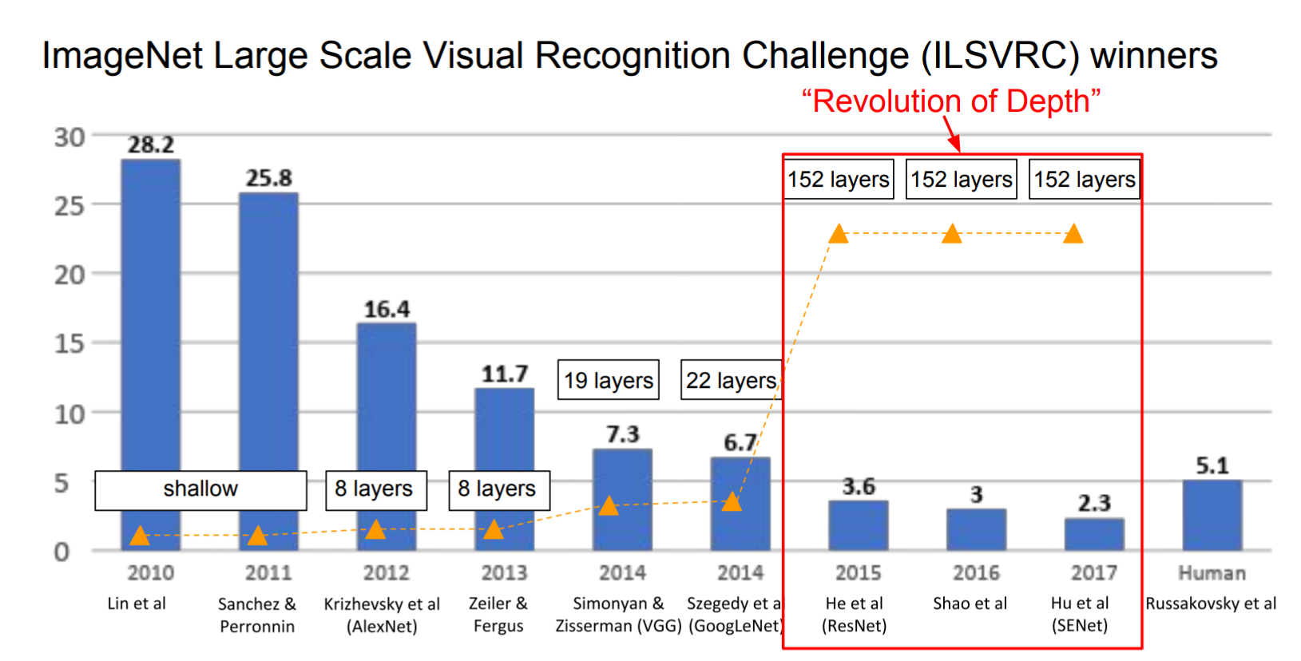
The popular CNN
LeNet, 1998
AlexNet, 2012
VGGNet, 2014
ResNet, 2015
Notes:
http://cs231n.github.io/neural-networks-1/

Slide 30
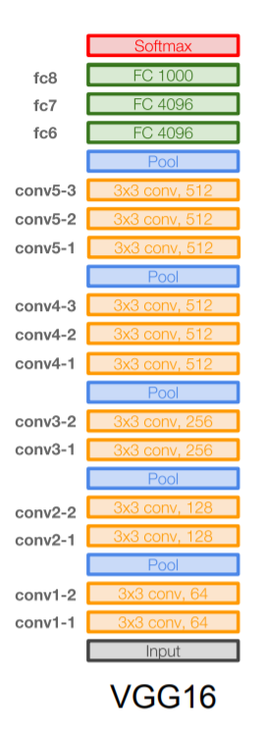
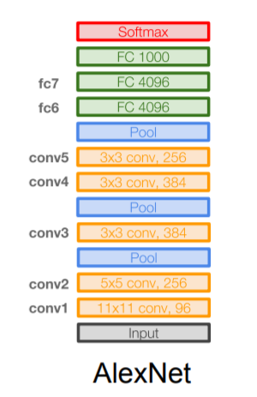
VGGNet
16 layers
Only 3*3 convolutions
138 million parameters

Slide 31
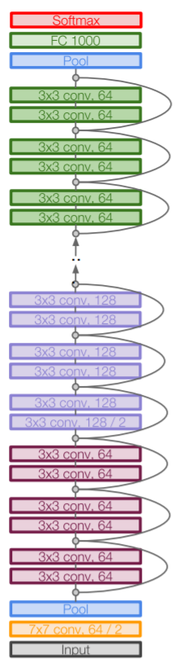
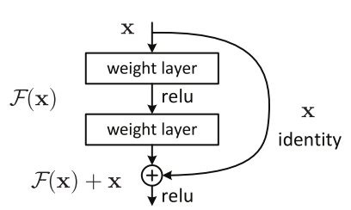
ResNet
152 layers
ResNet50

Slide 32
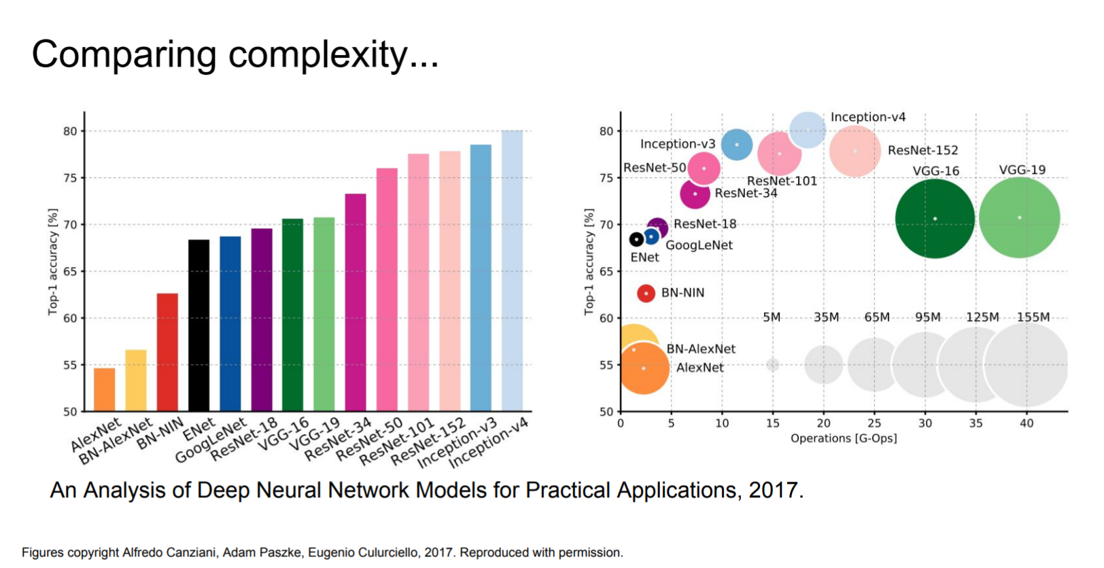
Computational complexity
The memory bottleneck
GPU, a few GB

Slide 33
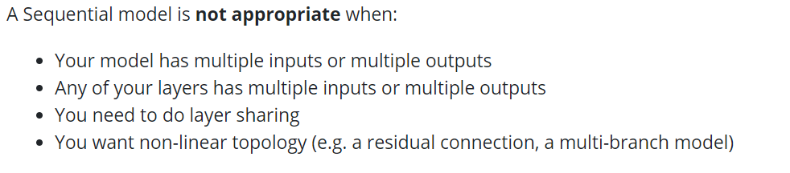
Using Keras Sequential Model https://keras.io/guides/sequential_model/
Add
Compile (Configuration)
Fit (Training)
Evaluate (Test)
Predict (Predict)

Slide 34
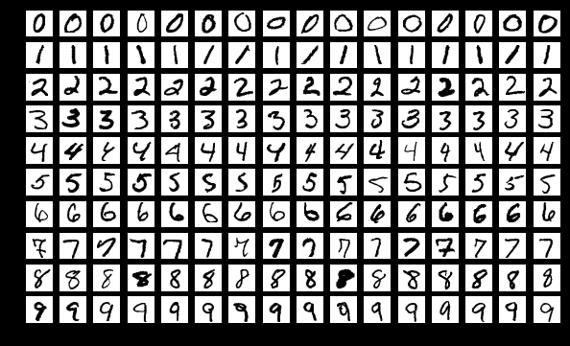
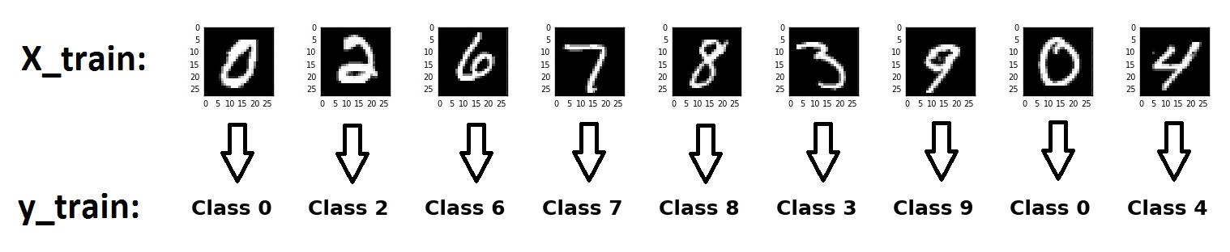
To classified Mnist Using Keras CNN : National Institute of Standards and Technology

Slide 35
Python Code
from keras.datasets import mnist
(x_train, y_train), (x_test, y_test) = mnist.load_data()
print(x_train.shape)
print(x_test.shape)
from skimage import io
io.imshow(x_train[0])
print(y_train[0]) # check label correctly

Slide 36
#first number is the photo number, then x axis, then y axis
print(x_train[0][15][16])
x_train.shape
x_train = x_train.reshape(60000,28,28,1)
print("after", x_train[0][0])
x_test = x_test.reshape(10000,28,28,1)
#encoding for Y
print(y_train)
y_train = keras.utils.to_categorical(y_train, 10)
print("after", y_train[0])
y_test = keras.utils.to_categorical(y_test, 10)
#encoding for Y
from keras.utils import np_utils
print(y_train)
y_train = np_utils.to_categorical(y_train, 10)
print("after", y_train[0])
y_test = np_utils.to_categorical(y_test, 10)

Slide 37
from keras.models import Sequential
from keras.layers import Dense, Dropout, Flatten, Conv2D, MaxPooling2D
model = Sequential()
model.add(Conv2D(32, (3,3), activation="relu", input_shape=(28,28,1)))
model.add(MaxPooling2D(pool_size=(2, 2)))
model.add(Conv2D(40, (4, 4), activation = "relu"))
model.add(MaxPooling2D(pool_size=(3, 3)))
model.add(Dropout(0.2))
model.add(Flatten())
model.add(Dense(128, activation="relu"))
model.add(Dropout(0.2))
model.add(Dense(64, activation="relu"))
model.add(Dropout(0.3))
model.add(Dense(10,activation='softmax'))
model.summary()

Slide 38
import keras
model.compile(loss=keras.losses.categorical_crossentropy, metrics=['accuracy'])
#model.fit(x_train, y_train, batch_size=500, epochs=2)
Model.fit(x_train, y_train)
model.evaluate(x_test, y_test)

Slide 39
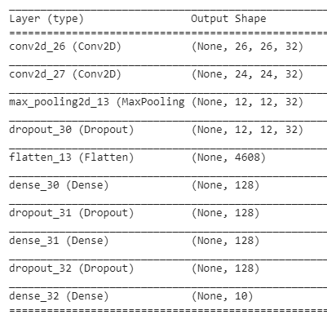
26-3+1=24
model = Sequential()
model.add(Conv2D(32, kernel_size=(3, 3),
activation='relu',
input_shape=(28,28,1)))
model.add(Conv2D(32, (3, 3), activation='relu'))
model.add(MaxPooling2D(pool_size=(2, 2)))
model.add(Dropout(0.1))
model.add(Flatten())
model.add(Dense(128, activation='relu'))
model.add(Dropout(0.1))
model.add(Dense(128, activation='relu'))
model.add(Dropout(0.1))
model.add(Dense(num_classes, activation='softmax'))
model.summary()
12 * 12* 32 = 4608
24/2

Slide 40
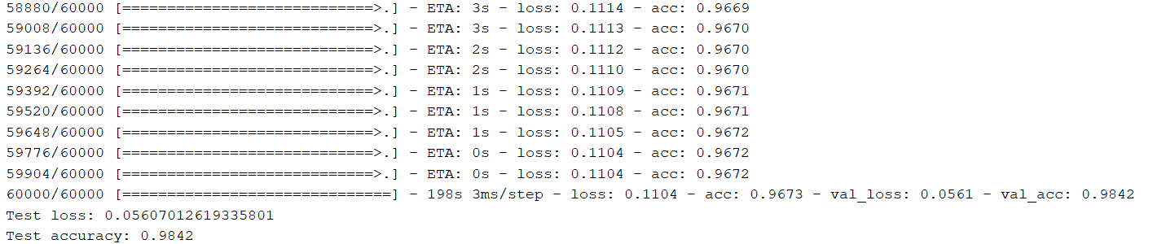
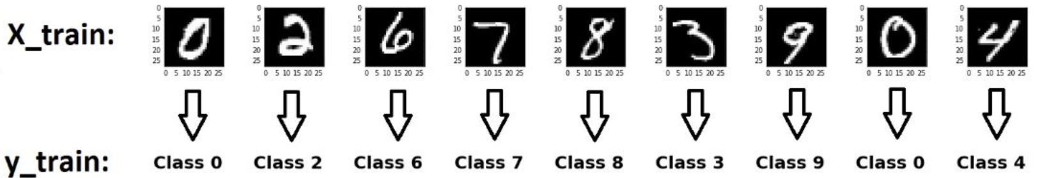
Final Results

Slide 41
CNN in Keras
Input
28 x 28 x 1
model = Sequential()
model.add(Conv2D(32, kernel_size=(3, 3),
activation='relu',
input_shape=(28,28,1)))
model.add(Conv2D(32, (3, 3), activation='relu'))
model.add(MaxPooling2D(pool_size=(2, 2)))
Convolution
26 x 26 x 32
Convolution
24 x 24 x 32
Max Pooling
12 x 12 x 32
Flattened

Slide 42
Output after convolution
in Keras
Input
28 x 28 x 1
26
Convolution
1 | 0 | 0 | 0 | 0 | 1
0 | 1 | 0 | 0 | 1 | 0
0 | 0 | 1 | 1 | 0 | 0
1 | 0 | 0 | 0 | 1 | 0
0 | 1 | 0 | 0 | 1 | 0
0 | 0 | 1 | 0 | 1 | 0
26 x 26 x 32
1 | 0 | 0 | 0 | 0 | 1
0 | 1 | 0 | 0 | 1 | 0
0 | 0 | 1 | 1 | 0 | 0
1 | 0 | 0 | 0 | 1 | 0
0 | 1 | 0 | 0 | 1 | 0
0 | 0 | 1 | 0 | 1 | 0
1 | 0 | 0 | 0 | 0 | 1
0 | 1 | 0 | 0 | 1 | 0
0 | 0 | 1 | 1 | 0 | 0
1 | 0 | 0 | 0 | 1 | 0
0 | 1 | 0 | 0 | 1 | 0
0 | 0 | 1 | 0 | 1 | 0
Convolution
1 | 0 | 0 | 0 | 0 | 1
0 | 1 | 0 | 0 | 1 | 0
0 | 0 | 1 | 1 | 0 | 0
1 | 0 | 0 | 0 | 1 | 0
0 | 1 | 0 | 0 | 1 | 0
0 | 0 | 1 | 0 | 1 | 0
26
24 x 24 x 32
Max Pooling
12 x 12 x 32
32 filters
Flattened

Slide 43
Exercise Configure CNN
 | Accuracy | Overfitting | Option
Batch Size | Smaller better | Y | 0?
Epoch | Bigger better | Y | 100?
Dropout Rate | Smaller better | Y | 0.2
#neurons | Bigger better | Y | Same as Input
# layer | Bigger Better | Y | 2
Activation Function | Hard to Say | ? | Relu, Sigmoid
Loss | Hard to Say | ? | MSE, Cross Entropy
Optimizer | Hard to Say | ? | Adam (With Momentum, LR)
Metrics | Hard to Say | ? | Accuracy

Slide 44
Optional

Slide 45
Data from Kaggle
https://www.kaggle.com/datasets/aryashah2k/breast-ultrasound-images-dataset?resource=download
https://www.kaggle.com/datasets/tourist55/alzheimers-dataset-4-class-of-images
https://www.kaggle.com/datasets/paultimothymooney/chest-xray-pneumonia
https://www.kaggle.com/datasets/tawsifurrahman/covid19-radiography-database (alternatively: https://tssglobalsingapore-my.sharepoint.com/:f:/g/personal/teohteiktoe_tssglobalsingapore_onmicrosoft_com/EtgAbDvO-HVFi91b7McMxCgBhKIpe2bOU0HIJ_KuIJ6giw?e=0U98mX)
https://www.kaggle.com/datasets/andrewmvd/medical-mnist

Slide 46
train_root = "C:/Users/Teoh Teik Teo/OneDrive - TSS Global Pte. Ltd/TT Library/AI Model/Data/Pneumonia/train"
test_root = "C:/Users/Teoh Teik Teo/OneDrive - TSS Global Pte. Ltd/TT Library/AI Model/Data/Pneumonia/test"
#if wanted to display image
from skimage import io
image = io.imread("C:/Users/Teoh Teik Teo/OneDrive - TSS Global Pte. Ltd/TT Library/AI Model/Data/Pneumonia/train/NORMAL/IM-0115-0001.jpeg")
print(image.shape)
io.imshow(image)

Slide 47
batch_size = 5
from keras.preprocessing.image import ImageDataGenerator
Generator = ImageDataGenerator()
train_data = Generator.flow_from_directory(train_root, (150, 150), batch_size=batch_size, shuffle= False)
test_data = Generator.flow_from_directory(test_root, (150, 150), batch_size=batch_size, shuffle= False)
#optional
print(train_data[0][0][0].shape)
# total 4317 data below to 5 clasess
print(len(train_data)) #4317/batch size
print(len(train_data[0])) #2, 1st image, 2nd is label
#print(train_data[0])
print(len(train_data[0][0])) #1st batch of 10 data
print(len(train_data[0][0][0])) #the image, the vertical
print(len(train_data[0][0][0][0])) #the image, the horizontal
print(len(train_data[0][0][0][0][0])) #the image, RGB

Slide 48
import tensorflow as tf
from matplotlib.pyplot import imshow
import os
im = train_data[0][0][0]
img = tf.keras.preprocessing.image.array_to_img(im)
imshow(img)
num_classes = len([i for i in os.listdir(train_root)])
print(num_classes)

Slide 49
import keras
from keras.datasets import mnist
from keras.models import Sequential
from keras.layers import Dense, Dropout, Flatten
from keras.layers import Conv2D, MaxPooling2D
model = Sequential()
model.add(Conv2D(32, (3, 3), input_shape=(150, 150, 3), activation='relu'))
model.add(MaxPooling2D(pool_size=(2, 2), strides=2))
model.add(Dropout(0.05))
model.add(Conv2D(32, (3, 3), activation='relu'))
model.add(MaxPooling2D(pool_size=(2, 2), strides=2))
model.add(Dropout(0.05))
model.add(Conv2D(64, (3, 3),activation='relu'))
model.add(MaxPooling2D(pool_size=(2, 2), strides=2))
model.add(Dropout(0.2))
model.add(Conv2D(64, (3, 3), activation='relu'))
model.add(MaxPooling2D(pool_size=(2, 2), strides=2))
model.add(Dropout(0.2))
model.add(Flatten())
model.add(Dense(128, activation='relu'))
model.add(Dropout(0.2))
model.add(Dense(num_classes, activation="softmax"))
model.summary()

Slide 50
#remove optimizer if needed
model.compile(loss=keras.losses.categorical_crossentropy, optimizer=keras.optimizers.Adam(), metrics=['accuracy'])
history = model.fit(train_data, batch_size = batch_size, epochs=2)
import matplotlib.pyplot as plt
plt.plot(history.history['accuracy'])
#plt.plot(history.history['val_accuracy'])
plt.title('model accuracy')
plt.ylabel('accuracy')
plt.xlabel('epoch')
plt.legend(['train', 'val'], loc='upper left')
plt.show()
plt.plot(history.history['loss'])
#plt.plot(history.history['val_loss'])
plt.title('model loss')
plt.ylabel('loss')
plt.xlabel('epoch')
plt.legend(['train', 'val'], loc='upper left')
plt.show()

Slide 51
# score = model.evaluate(train_data)
# print(score)
score = model.evaluate(test_data)
print(score)
#Alternatively if predict_classes module not there:
predict_x=model.predict(test_data)
pred=np.argmax(predict_x,axis=1)
import seaborn as sns
pred = model.predict_classes(test_data)
from sklearn.metrics import confusion_matrix
cm = confusion_matrix(test_data.classes, pred)
sns.heatmap(cm, annot=True)
#depends on number of classes
print((cm[0,0]+cm[1,1])/(sum(sum(cm))))
from keras.models import save_model
save_model(model, "Pneumonia")

Slide 52
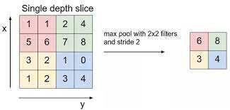
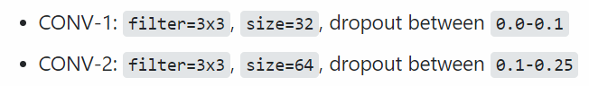
Parameter to configure – Google for the norm
Batch Size (Smaller means more accurate but take more time)
Input Size can consider 150, 150
CNN Layer
Change 32 to any number you like, example 64: Conv2D(32, (3, 3))
Change no of CNN layer (Add or Remove)
model.add(Conv2D(64, (3, 3), activation='relu'))
model.add(MaxPooling2D(pool_size=(2, 2), strides=2))
model.add(Dropout(0.05))
Change Dropout rate
Change strides to 1 and try
model.fit(train_data, batch_size = batch_size, epochs=10) – Change batch size (decrease means better result but take more time) and epochs (increase means better result but take more time)
Note that epochs need to increase if the results is still improving
model.add(Dense(128, activation='relu’)) – Change 512 to any number you like but try to be smaller than Flatten
model.add(Dropout(0.05)) – try to use 0.2

Slide 53
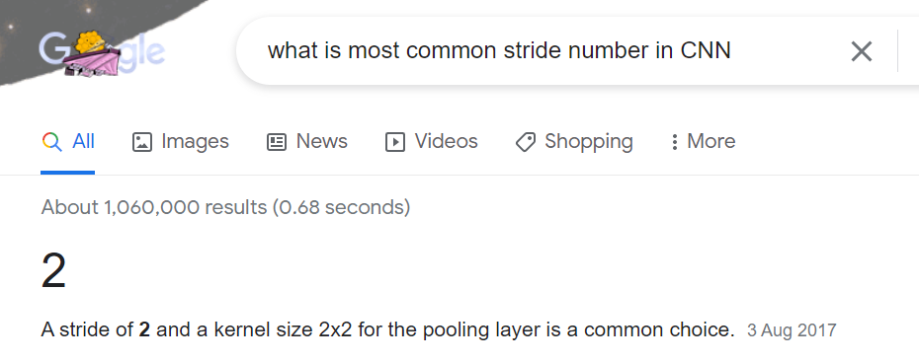
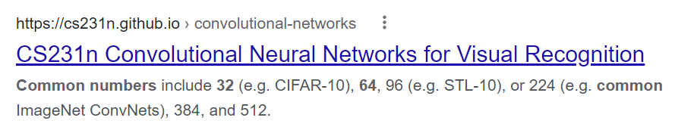
Stride
Number of filter

Slide 54
For Prediction (Grey)
from keras.models import load_model
from PIL import Image #use PIL
import numpy as np
model = load_model("Pneumonia")
image = Image.open("/Users/liqun/Desktop/KS/MyPython/chest_xray/val/NORMAL/NORMAL2-IM-1427-0001.jpeg")
img = np.asarray(image)
img.resize((150,150,3))
img = np.asarray(img, dtype="float32") #need to transfer to np to reshape
img = img.reshape(1, img.shape[0], img.shape[1], img.shape[2]) #rgb to reshape to 1,100,100,3
print(model.predict(img))
from keras.models import load_model
from PIL import Image #use PIL
import numpy as np
model = load_model("Pneumonia")
import cv2
image = cv2.imread("c:/Users/Teoh Teik Teo/OneDrive - TSS Global Pte. Ltd/TT Library/AI Model/Data/Pneumonia/val/NORMAL/NORMAL2-IM-1427-0001.jpeg")
gray = cv2.cvtColor(image, cv2.COLOR_BGR2GRAY)
img = cv2.merge([gray,gray,gray])
img.resize((150,150,3))
img = np.asarray(img, dtype="float32") #need to transfer to np to reshape
img = img.reshape(1, img.shape[0], img.shape[1], img.shape[2]) #rgb to reshape to 1,100,100,3
img.shape
print(model.predict(img))

Slide 55
For Prediction (Color)
from keras.models import load_model
from PIL import Image #use PIL
import numpy as np
model = load_model("Flower")
img = Image.open("rose.jpg") #rose = 3, sunflower = 4, tulip 5
img = img.resize((150,150))
img = np.asarray(img, dtype="float32") #need to transfer to np to reshape
img = img.reshape(1, img.shape[0], img.shape[1], img.shape[2]) #rgb to reshape to 1,100,100,3
img.shape
print(model.predict(img))

Slide 56
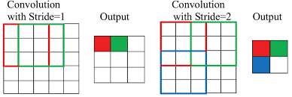
Stride

Slide 57
Front End
<html>
<h1>Upload new File</h1>
<form method="post" action = "/" enctype="multipart/form-data">
<input type="file" name="file">
<input type="submit" value="Upload">
</form>
{{result}}
</html>

Slide 58
from flask import Flask, render_template, request
from werkzeug.utils import secure_filename
from skimage import io
from keras.models import load_model
import cv2 #remove for cloud
from PIL import Image #use PIL
import numpy as np
app = Flask(__name__)
@app.route('/', methods=['GET', 'POST'])
def upload_file():
if request.method == 'POST':
file = request.files['file']
print("File Received")
filename = secure_filename(file.filename)
print(filename)
file.save("./static/"+filename) #remove when cloud
file = open("./static/"+filename,"r") #remove when cloud
model = load_model("Pneumonia")
image = cv2.imread("./static/"+filename) #remove for cloud
gray = cv2.cvtColor(image, cv2.COLOR_BGR2GRAY) #remove for cloud
img = cv2.merge([gray,gray,gray]) #remove for cloud
# for cloud add this (cloud need to use PIL instead of CV2): image = Image.open(file)
# for cloud add this: img = np.asarray(image)
img.resize((150,150,3))
img = np.asarray(img, dtype="float32") #need to transfer to np to reshape
img = img.reshape(1, img.shape[0], img.shape[1], img.shape[2]) #rgb to reshape to 1,100,100,3
pred=model.predict(img)
return(render_template("index.html", result=str(pred)))
else:
return(render_template("index.html", result="WAITING"))
if __name__ == "__main__":
app.run()
Back End

Slide 59
from flask import Flask, render_template, request
from werkzeug.utils import secure_filename
from keras.models import load_model
from PIL import Image #use PIL
import numpy as np
app = Flask(__name__)
@app.route('/', methods=['GET', 'POST'])
def init():
if request.method == 'POST':
file = request.files['file']
print("File Received")
filename = secure_filename(file.filename)
print(filename)
# Open the image form working directory
image = Image.open(file)
model = load_model("Pneumonia")
img = np.asarray(image)
img.resize((150,150,3))
img = np.asarray(img, dtype="float32") #need to transfer to np to reshape
img = img.reshape(1, img.shape[0], img.shape[1], img.shape[2]) #rgb to reshape to 1,100,100,3
pred=model.predict(img)
return(render_template("index.html", result=str(pred)))
else:
return(render_template("index.html", result="WAITING"))
if __name__ == "__main__":
app.run()
Cloud

Slide 60
requirements.txt
absl-py==1.0.0
astunparse==1.6.3
cachetools==5.0.0
certifi==2021.10.8
charset-normalizer==2.0.11
click==8.0.3
colorama==0.4.4
Flask==2.0.2
flatbuffers==2.0
gast==0.5.3
google-auth==2.6.0
google-auth-oauthlib==0.4.6
google-pasta==0.2.0
grpcio==1.43.0
gunicorn==20.1.0
h5py==3.6.0
idna==3.3
importlib-metadata==4.10.1
itsdangerous==2.0.1
Jinja2==3.0.3
joblib==1.1.0
keras==2.8.0
Keras-Preprocessing==1.1.2
libclang==13.0.0
Markdown==3.3.6
MarkupSafe==2.0.1
numpy==1.22.2
oauthlib==3.2.0
opt-einsum==3.3.0
protobuf==3.19.4
pyasn1==0.4.8
pyasn1-modules==0.2.8
requests==2.27.1
requests-oauthlib==1.3.1
rsa==4.8
scikit-learn==1.0.2
scipy==1.8.0
six==1.16.0
sklearn==0.0
tensorboard==2.8.0
tensorboard-data-server==0.6.1
tensorboard-plugin-wit==1.8.1
tensorflow-io-gcs-filesystem==0.24.0
termcolor==1.1.0
tf-estimator-nightly==2.8.0.dev2021122109
threadpoolctl==3.1.0
typing_extensions==4.0.1
urllib3==1.26.8
Werkzeug==2.0.3
wrapt==1.13.3
zipp==3.7.0
pillow==9.0
tensorflow-cpu
Procfile (must not have .txt extension)
web: gunicorn app:app

Slide 61
# Using Resnet
#from tensorflow import keras
#from keras.applications.resnet import ResNet50
#from tensorflow.keras.applications.resnet50 import ResNet50
from keras.applications.resnet50 import ResNet50
from keras.models import Model
import keras
restnet = ResNet50(include_top=False, weights='imagenet', input_shape=(150,150,3))
restnet.summary()
from keras.layers import Conv2D, MaxPooling2D, Flatten, Dense, Dropout, InputLayer
from keras.models import Sequential
from keras import optimizers
model1 = Sequential()
model1.add(restnet)
model1.add(Flatten())
model1.add(Dense(128, activation='relu'))
model1.add(Dropout(0.2))
model1.add(Dense(64, activation='relu'))
model1.add(Dropout(0.2))
model1.add(Dense(num_classes, activation="softmax"))
model1.compile(loss=keras.losses.categorical_crossentropy, optimizer=keras.optimizers.Adam(), metrics=['accuracy'])
history = model1.fit(train_data, batch_size = batch_size, epochs=10)
https://stackoverflow.com/questions/54682539/i-am-not-able-to-import-resnet-from-keras-applications-module
resnet
score = model1.evaluate(test_data)
print(score)

Slide 62
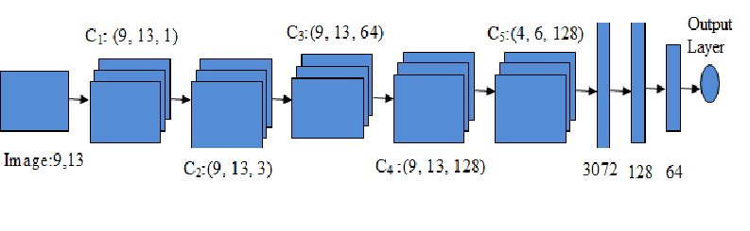
RESNET Optimization – Google for recommendation
MLP layer – Depending on Flatten size – the bigger the size, the MLP neurons and layers should be more. Min one layer – recommend 1 to 2 layers
model1.add(Dense(128, activation='relu'))
model1.add(Dropout(0.2))
model1.add(Dense(64, activation='relu'))
model1.add(Dropout(0.2))

Slide 63
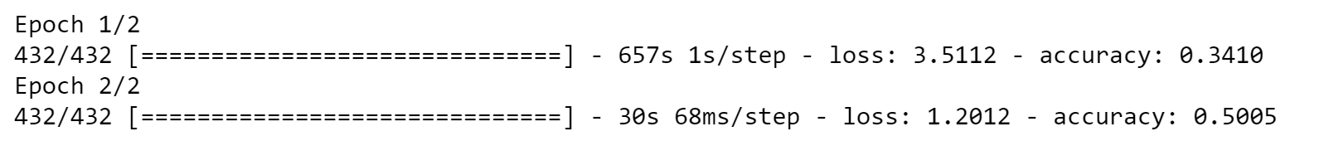
RESNET useful? Yes, From 50% accuracy to 71% accuracy.

Slide 64
Transformer

Slide 65
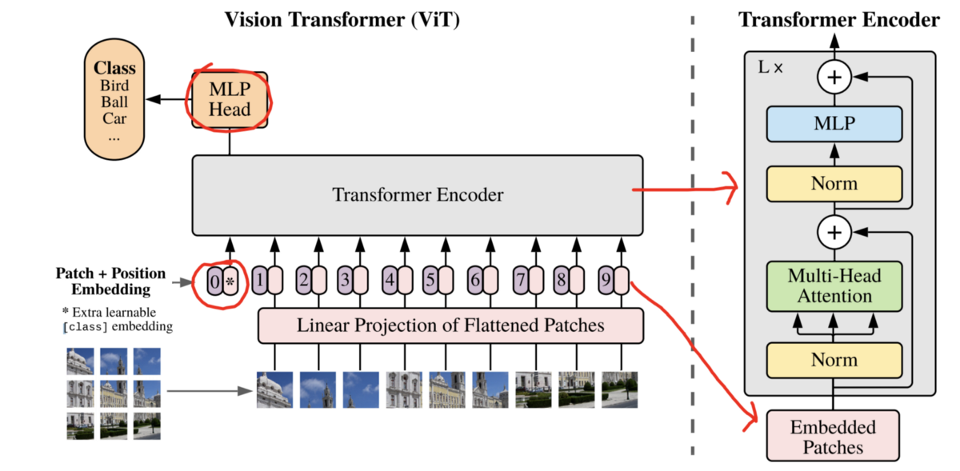
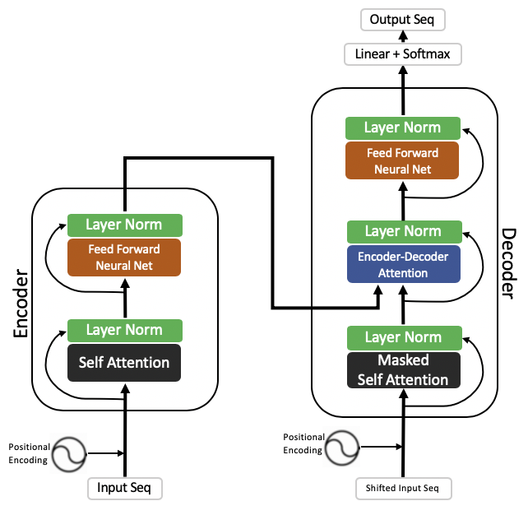
Transformer, Encoder, Attention
The transformer is the model, while the attention is a technique used by the model.

Slide 66
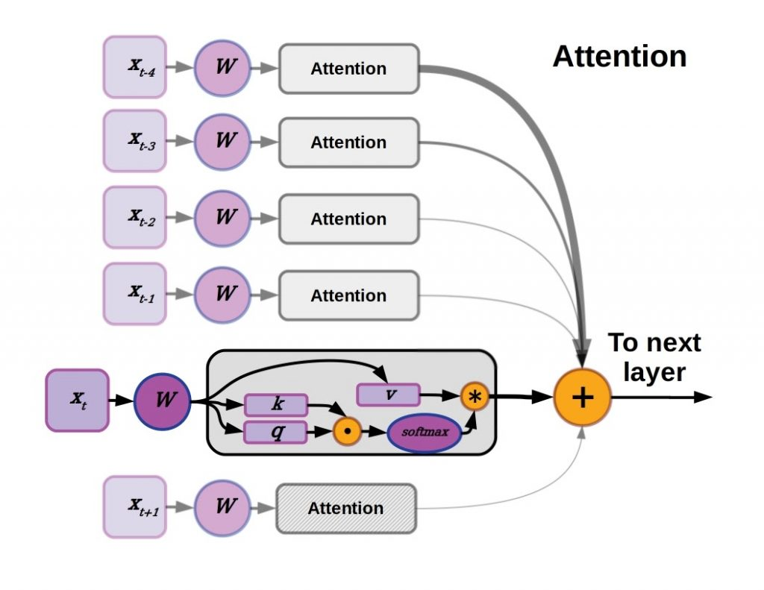
Attention

Slide 67
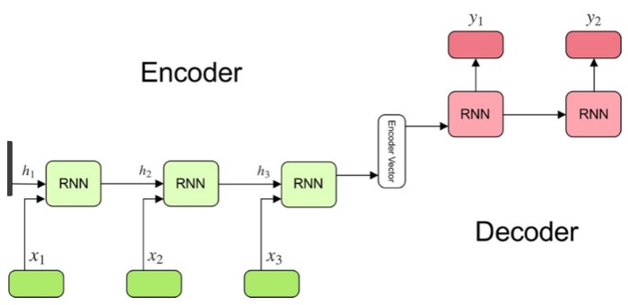
Encoder vs Decoder

Slide 68
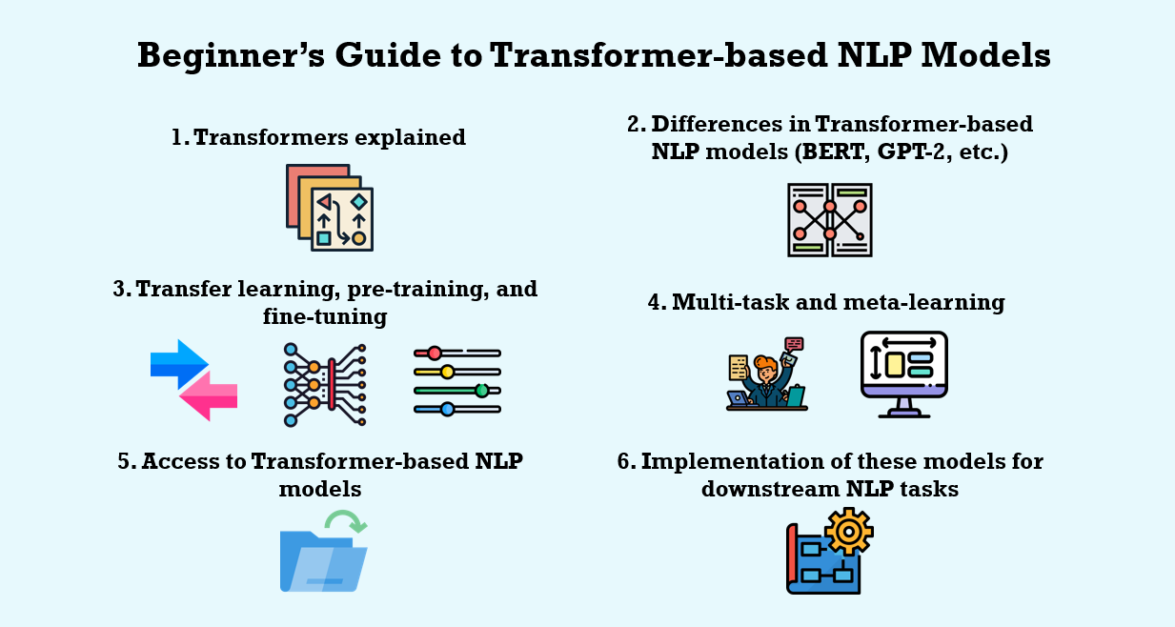
Transformer usage

Slide 69
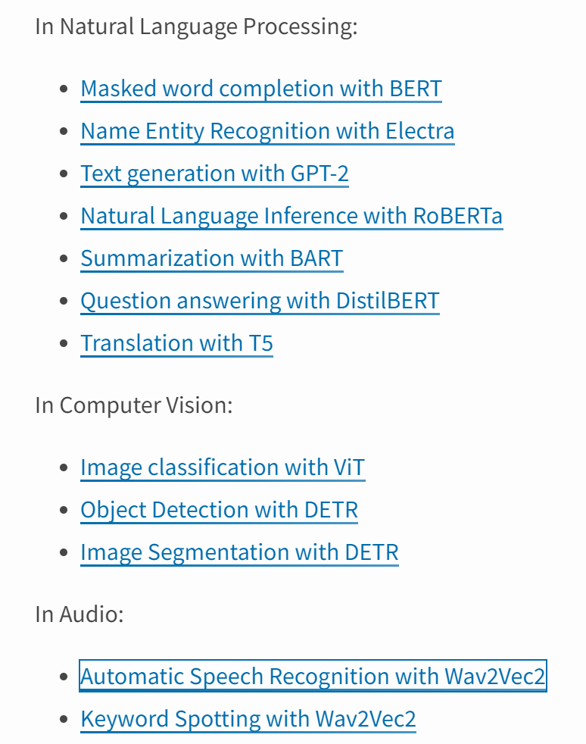
Transformer – Python Library - https://pypi.org/project/transformers/

Slide 70

Transformer in Image: 15m with 22k class
https://pypi.org/project/transformers/
from transformers import ViTFeatureExtractor, ViTForImageClassification
from PIL import Image
import requests
url = 'http://images.cocodataset.org/val2017/000000039769.jpg'
image = Image.open(requests.get(url, stream=True).raw)
feature_extractor = ViTFeatureExtractor.from_pretrained('google/vit-base-patch16-224')
model = ViTForImageClassification.from_pretrained('google/vit-base-patch16-224')
inputs = feature_extractor(images=image, return_tensors="pt")
outputs = model(**inputs)
logits = outputs.logits
# model predicts one of the 1000 ImageNet classes
predicted_class_idx = logits.argmax(-1).item()
print("Predicted class:", model.config.id2label[predicted_class_idx])

Slide 71
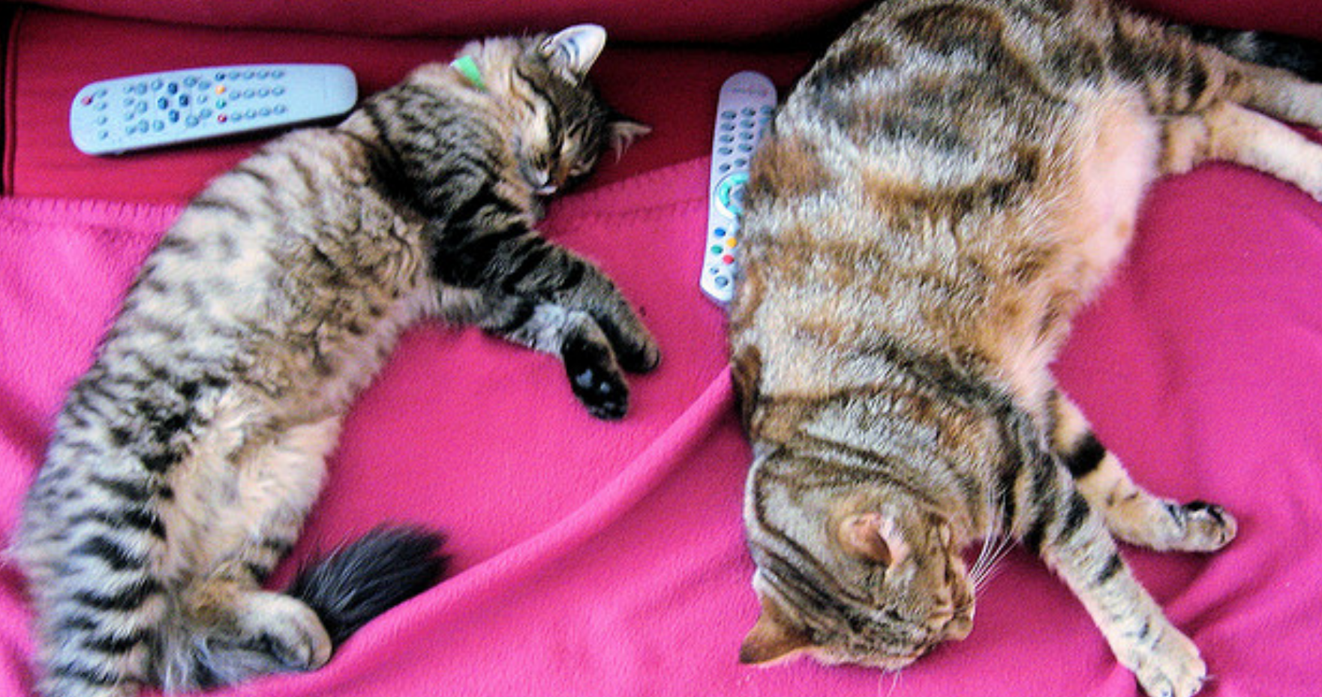
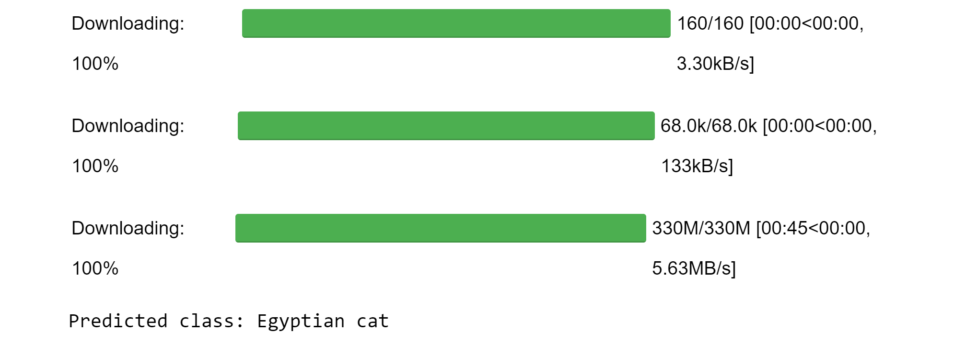
Results

Slide 72
Configure you network
Using your own layer and # of neurons
What is the accuracy?

Slide 73
Configure you network
Using your own layer and # of neurons
What is the accuracy?

